Slide 1
The Lost Generation Underemployment
By Gary Yu

Slide 2
Introduction
I wrote a paper on an issue that affects allot people like us
Recent College students/graduates with bachelor's degree (Gould and Kassa)
The Young (Gould and Kassa)
People in liberal arts disciplines (“The Labor Market for Recent College Graduates“)

Slide 3
Definition
Underemployment is
Part timers looking for full-time work
Highly skilled people doing a low skill job
Intext-citations(Chen 1)

Slide 4
The Numbers
In Feb 2021
59.5% of Liberal arts majors were underemployed
49.7% of Political Science majors were underemployed
39.5% of Economics majors were underemployed
37.6% of Finance majors were underemployed
24.1% of Accounting majors were underemployed
Intext-citations: (“The Labor Market for Recent College Graduates“)(Also for the next page)

Slide 5
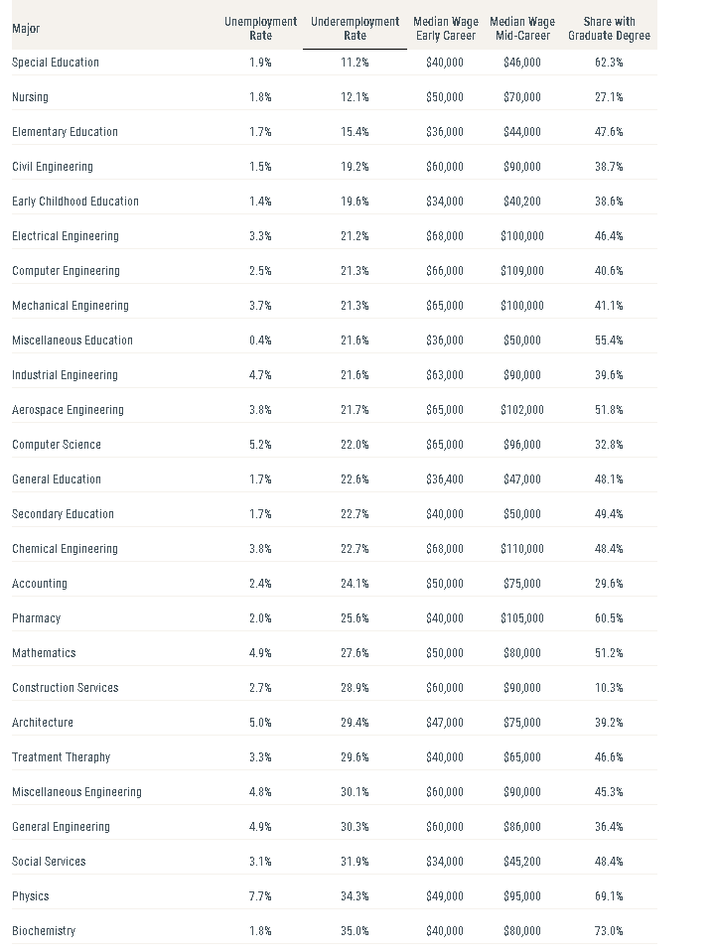
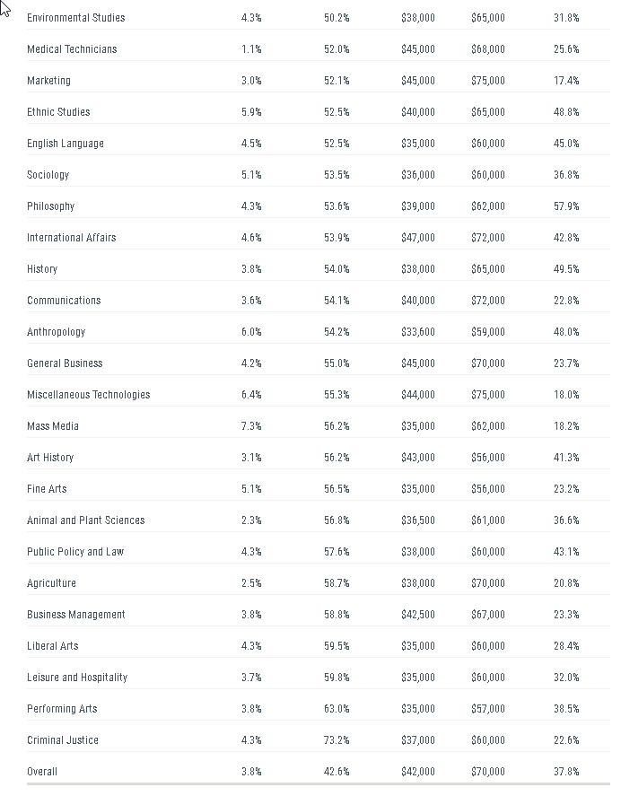

Slide 6
Cause?
Globalization & Outsourcing( As an American you are competing with everyone including college students in other countries with H1B visas for example) (For unemployment, but also should be the case for unemployment) (Inaba 1)
Automation (“Our Labor Market in Crisis: Paving A New Path to the Future of Work”)
Skills Mismatch (Abel and Deitz 1)
Oversupply of college majors thus forcing requirements at jobs to increased(credentialism) (Fallows 1)
Companies trying to reduce Labor costs (Rosenbaum)
High executive pay, and shareholder prioritized over stakeholders(everyone affected by a company) (Rosenbaum)

Slide 7
Why We Should solve it
Inefficient for the economy as a whole (Blanchflower and Bell 1)
Leads to health(both physical, and mental) problems down the road for individual actors(Burris 1)
My not in the essay theory as a political science BA graduate is that it could destabilized the US political system/democracy ending with either a reactionary or socialist government at best or an Alt-right or Left Authoritarian armed uprising or maybe just a civil war, and or increased political polarization (“Private Sector. Don't Just Stand There, Do Something BIG!”)

Slide 8
Who is getting the good jobs
I suspect
Extroverted people with good networking skills, and lots of friends(Just a guess) (Featherstone)
People who are more wealthily, and thus have good connections(Fisher)
Nepotism(Getting hired by at a relative’s firm) (Fisher)
People with high demand skills, and experience (Liu)
People with good majors with low underemployment(Ex. Computer Science, Nursing, and Engineering) (“The Labor Market for Recent College Graduates”)
Some Luck

Slide 9
What you can do before graduating, and entering the workforce
Internships, internships, internships(paid<unpaid<none)
Networking with professors, TAs, and friends
Resume, Cover-Letter examinations/practice
Maybe get a masters or PHD if you can(Be careful masters costs lots of money)

Slide 10
What you can personally do to get a job after getting a degree
From order of effectiveness(Better at the top worst at the bottom)(From my own experience)
Paid Internship to Job
Networking
Job fairs
Applying at the company’s website
Applying on LinkedIn

Slide 11
Public Policy Solutions
Government Incentive to hire people(Tax credits & Cuts, stimulus programs, etc.)
Gives incentive to companies to hire more vs fire & keep labor costs low to appease lower capital gains vs income tax situation in our tax cut (“Topic No. 409 Capital Gains and Losses”)
Force Colleges to have better career prep, or force them to find a job above a certain income for all students(like many coding bootcamp schools)
(“Columbus Coding Bootcamp” )

Slide 12
MLA Citations
Gould , Elise, and Melat Kassa. “Young Workers Hit Hard by the COVID-19 Economy: Workers Ages 16–24 Face High Unemployment and an Uncertain Future.” Economic Policy Institute, Economic Policy Institute, 14 Oct. 2020, www.epi.org/publication/young-workers-covid-recession/.
Chen, James. “Underemployment.” Investopedia, Investopedia, 30 June 2021, www.investopedia.com/terms/u/underemployment.asp#:~:text=What%20Is%20Underemployment%3F&text=People%20who%20are%20classified%20as,not%20at%20their%20full%20capability.
The Labor Market for Recent College Graduates - FEDERAL RESERVE BANK of NEW YORK, New York Federal Reserve , 12 Feb. 2021, www.newyorkfed.org/research/college-labor-market/college-labor-market_compare-majors.html.
Inaba, Chihiro. “The Effects of Globalization on Job Choice and Unemployment under Labor Search Friction*.”
“Our Labor Market in Crisis: Paving A New Path to the Future of Work.” Epicenter, Harvard University , 23 Mar. 2021, epicenter.wcfia.harvard.edu/blog/our-labor-market-crisis-paving-new-path-future-work.
Fallows, James. “The Case Against Credentialism.” The Atlantic, Atlantic Media Company, 1 Dec. 1985, www.theatlantic.com/magazine/archive/1985/12/the-case-against-credentialism/308286/.
Rosenbaum, Eric. “60% Of Big US Corporations Say a Head Count Reduction Is Coming in 2020.” CNBC, CNBC, 12 Dec. 2019, www.cnbc.com/2019/12/12/60percent-of-big-us-corporations-say-head-count-reduction-is-coming-in-2020.html.
Abel, Jaison, and Richard Deitz. “Underemployment in the Early Careers of College Graduates Following the Great Recession.” UNDEREMPLOYMENT IN THE EARLY CAREERS OF COLLEGE GRADUATES FOLLOWING THE GREAT RECESSION, Sept. 2016, pp. 1–51., doi:10.3386/w22654.
Featherstone, Emma. “How Extroverts Are Taking the Top Jobs - and What Introverts Can Do about It.” The Guardian, Guardian News and Media, 23 Feb. 2018, www.theguardian.com/business-to-business/2018/feb/23/how-extroverts-are-taking-the-top-jobs-and-what-introverts-can-do-about-it.

Slide 13
MLA Citations Part 2
Fisher, Julia Freeland. “How to Get a Job Often Comes down to One Elite Personal Asset, and Many People Still Don't Realize It.” CNBC, CNBC, 14 Feb. 2020, www.cnbc.com/2019/12/27/how-to-get-a-job-often-comes-down-to-one-elite-personal-asset.html.
Liu, Jennifer. “Hiring for These Jobs Is on the Rise in 2021, According to LinkedIn.” CNBC, CNBC, 12 Jan. 2021, www.cnbc.com/2021/01/12/hiring-for-these-jobs-is-on-the-rise-in-2021-according-to-linkedin.html.
“Topic No. 409 Capital Gains and Losses.” Internal Revenue Service, www.irs.gov/taxtopics/tc409.
“Columbus Coding Bootcamp.” Tech Elevator Coding Bootcamp, www.techelevator.com/columbus.
“Private Sector. Don't Just Stand There, Do Something BIG!” California Management Review, cmr.berkeley.edu/2020/07/private-sector/.
Bell, David N.F., and David Blanchflower. “Underemployment in the US and Europe.” UNDEREMPLOYMENT IN THE US AND EUROPE, 2018, pp. 1–1., doi:10.3386/w24927.
Burris, Beverly H. “The Human Effects of Underemployment.” Social Problems, vol. 31, no. 1, 1983, pp. 96–110., doi:10.2307/800412.

Slide 14
Discussion

